Slide 1

THIRD REVIEW
A Data-Driven Approach for Crop Selection using Soil Health and Food Price Data
Guided by,
Dr.R.Nallakumar M.E, MBA, Ph.D.,
Associate Professor,
Department of Artificial Intelligence and Data Science,
Karpagam Institute of Technology,
Coimbatore.
Presented by
S.ARCHANA (721220243003),
S.LINKEDH (721220243028),
M.PRASANTH(721220243045),
K.SRIKANTH(721220243053),
Department of Artificial Intelligence and Data Science,
Karpagam Institute of Technology,
Coimbatore.

Slide 2
Outline
Abstract
Module Description and Implementation
Module Diagrams (DFD)
Algorithm Explanations
Project Screen Shots and Demo
Publication Details
International Conference
International Journal
References

Slide 3
ABSTRACT
This research introduces a data-driven framework for suggesting suitable plants by analyzing soil health and food prices. It aims to enhance agricultural decision-making by integrating these factors.
Through data collection, preprocessing, and feature engineering, a predictive model is developed, correlating soil attributes and market costs with plant performance. This model aids in identifying optimal crops for specific locations. By omitting the user interface aspect, the focus remains on technical aspects.
The project holds potential for optimizing crop choices, leading to improved agricultural yield and economic outcomes.

Slide 4
LIST OF MODULES
Data Collection and Preprocessing (Module 1)
Feature Engineering and Selection Module (Module 2)
Model Development and Training Module
(Module 3)
Validation and Optimization Module (Module 4)

Slide 5
MODULE 1
Data Collection and Preprocessing
The "Data Collection and Preprocessing" module involves gathering soil health and food price data, ensuring its accuracy through cleaning and integration.
The data is then transformed into a consistent format and stored for subsequent analysis.
This module lays the foundation for building a predictive model by providing high-quality, structured data that encompasses both soil characteristics and market costs.

Slide 6
Data Collection and Preprocessing
Soil Health Data Gathering: This component involves collecting soil-related data, such as soil composition, pH levels, nutrient content, moisture levels, and other relevant soil parameters. This data is crucial for determining the suitability of specific plant species in different areas.
Food Price Data Acquisition: This part focuses on acquiring data related to food prices, which can include historical and current price information for various agricultural products in different regions. This data can be obtained from government sources, agricultural market reports, or data providers.

Slide 7
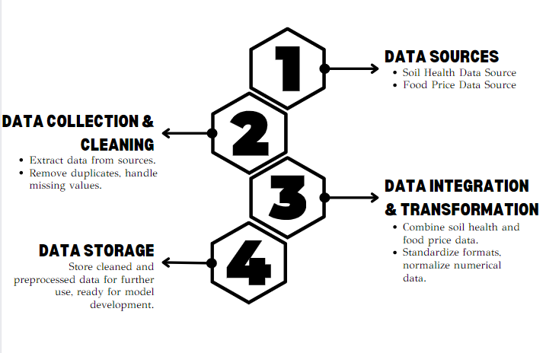
Data Collection and Preprocessing – Data Flow Diagram

Slide 8
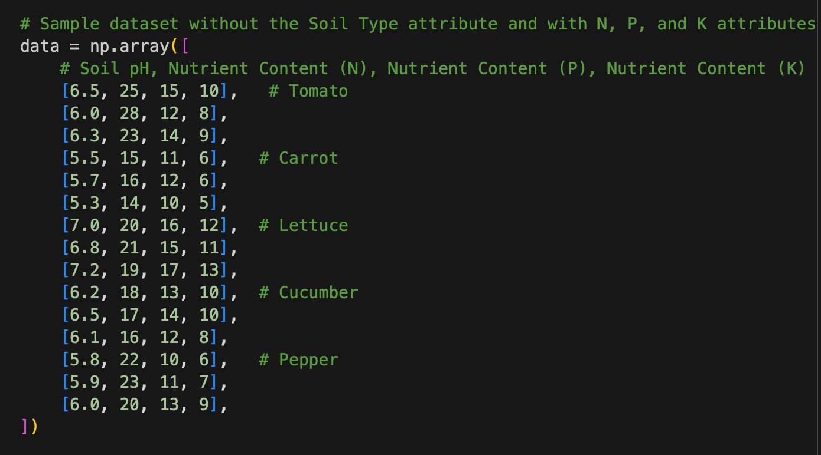
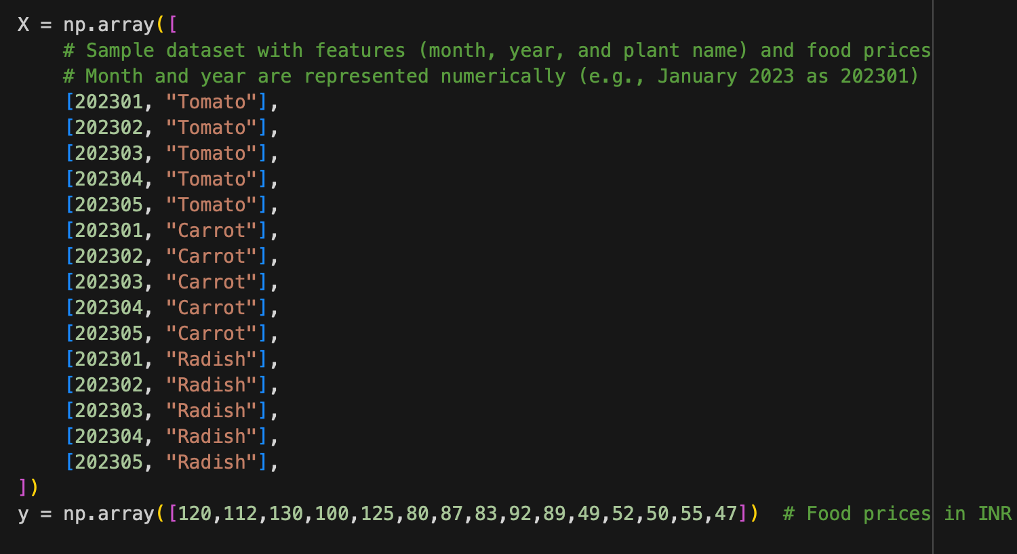
Data Collection and Preprocessing – Screen Shots
Input Dataset for Training the Model
The input data comprising various plant features like sunlight exposure, water needs, soil pH, temperature range, and growth habits. Each plant is represented as a data point with these features as attributes.

Slide 9
MODULE 2
Feature Engineering and Selection Module
The "Feature Engineering and Selection" module refines data for model development. Relevant features are identified from the integrated data, such as nutrient levels and pH. Unnecessary attributes are removed, and if required, new features are generated.
The resulting dataset forms the basis for training the predictive model, ensuring that only the most impactful and meaningful features are considered in the analysis.

Slide 10
Feature Engineering and Selection Module
Feature Engineering:
Data Transformation : Raw data, including soil health and food price data, often requires preprocessing.
Feature Creation : Engineers may create new features from the existing data to capture valuable information.
Feature Selection:
Dimensionality Reduction : Applied to reduce the dimensionality of the dataset while retaining important information.
Machine Learning-Based Selection: Some feature selection can be automated using machine learning models.

Slide 11
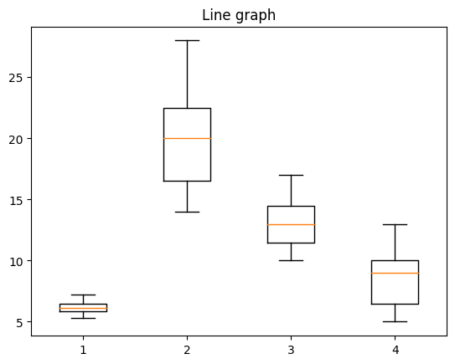
DATA PREPROCESSING AND FEATURE ENGINEERING Screenshot
By analyzing the box plot against pH, Nitrogen content, Phosphorous content and Potassium content, we infer a concise an informative representation of data distribution, enabling soil scientists and agricultural experts to gain insights into key statistics and variations within these essential soil properties.

Slide 12
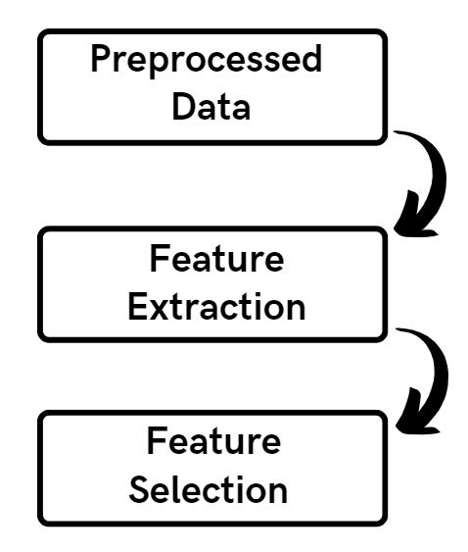
Feature Engineering and Selection Module Data Flow Diagram

Slide 13
Module 3
Model Development and Training Module
The "Model Development and Training" module creates a predictive model using machine learning techniques. It employs the refined dataset to establish correlations between soil health, food prices, and plant growth.
The model undergoes training using historical data, learning patterns and relationships. By utilizing advanced algorithms, the module enables the model to make accurate predictions about optimal plant choices based on soil characteristics and market conditions.

Slide 14
MODEL DEVELOPMENT – Algorithm Implemented
Decision Tree:
A decision tree algorithm partitions the data based on features to create a tree-like structure for classification or regression. It splits data based on attributes to maximize information gain or minimize impurity, resulting in a series of decisions that lead to predictions.
K-nearest neighbors (KNN):
KNN is a non-parametric algorithm that classifies data based on the majority vote of its neighbors. It calculates distances between data points and assigns a class label based on the class of its K nearest neighbors. KNN is effective for both classification and regression tasks and requires no training phase.

Slide 15
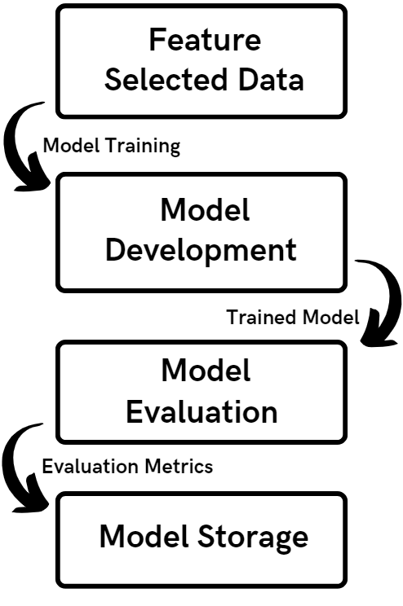
MODEL DEVELOPMENT AND TRAINING MODULE Data Flow Diagram

Slide 16
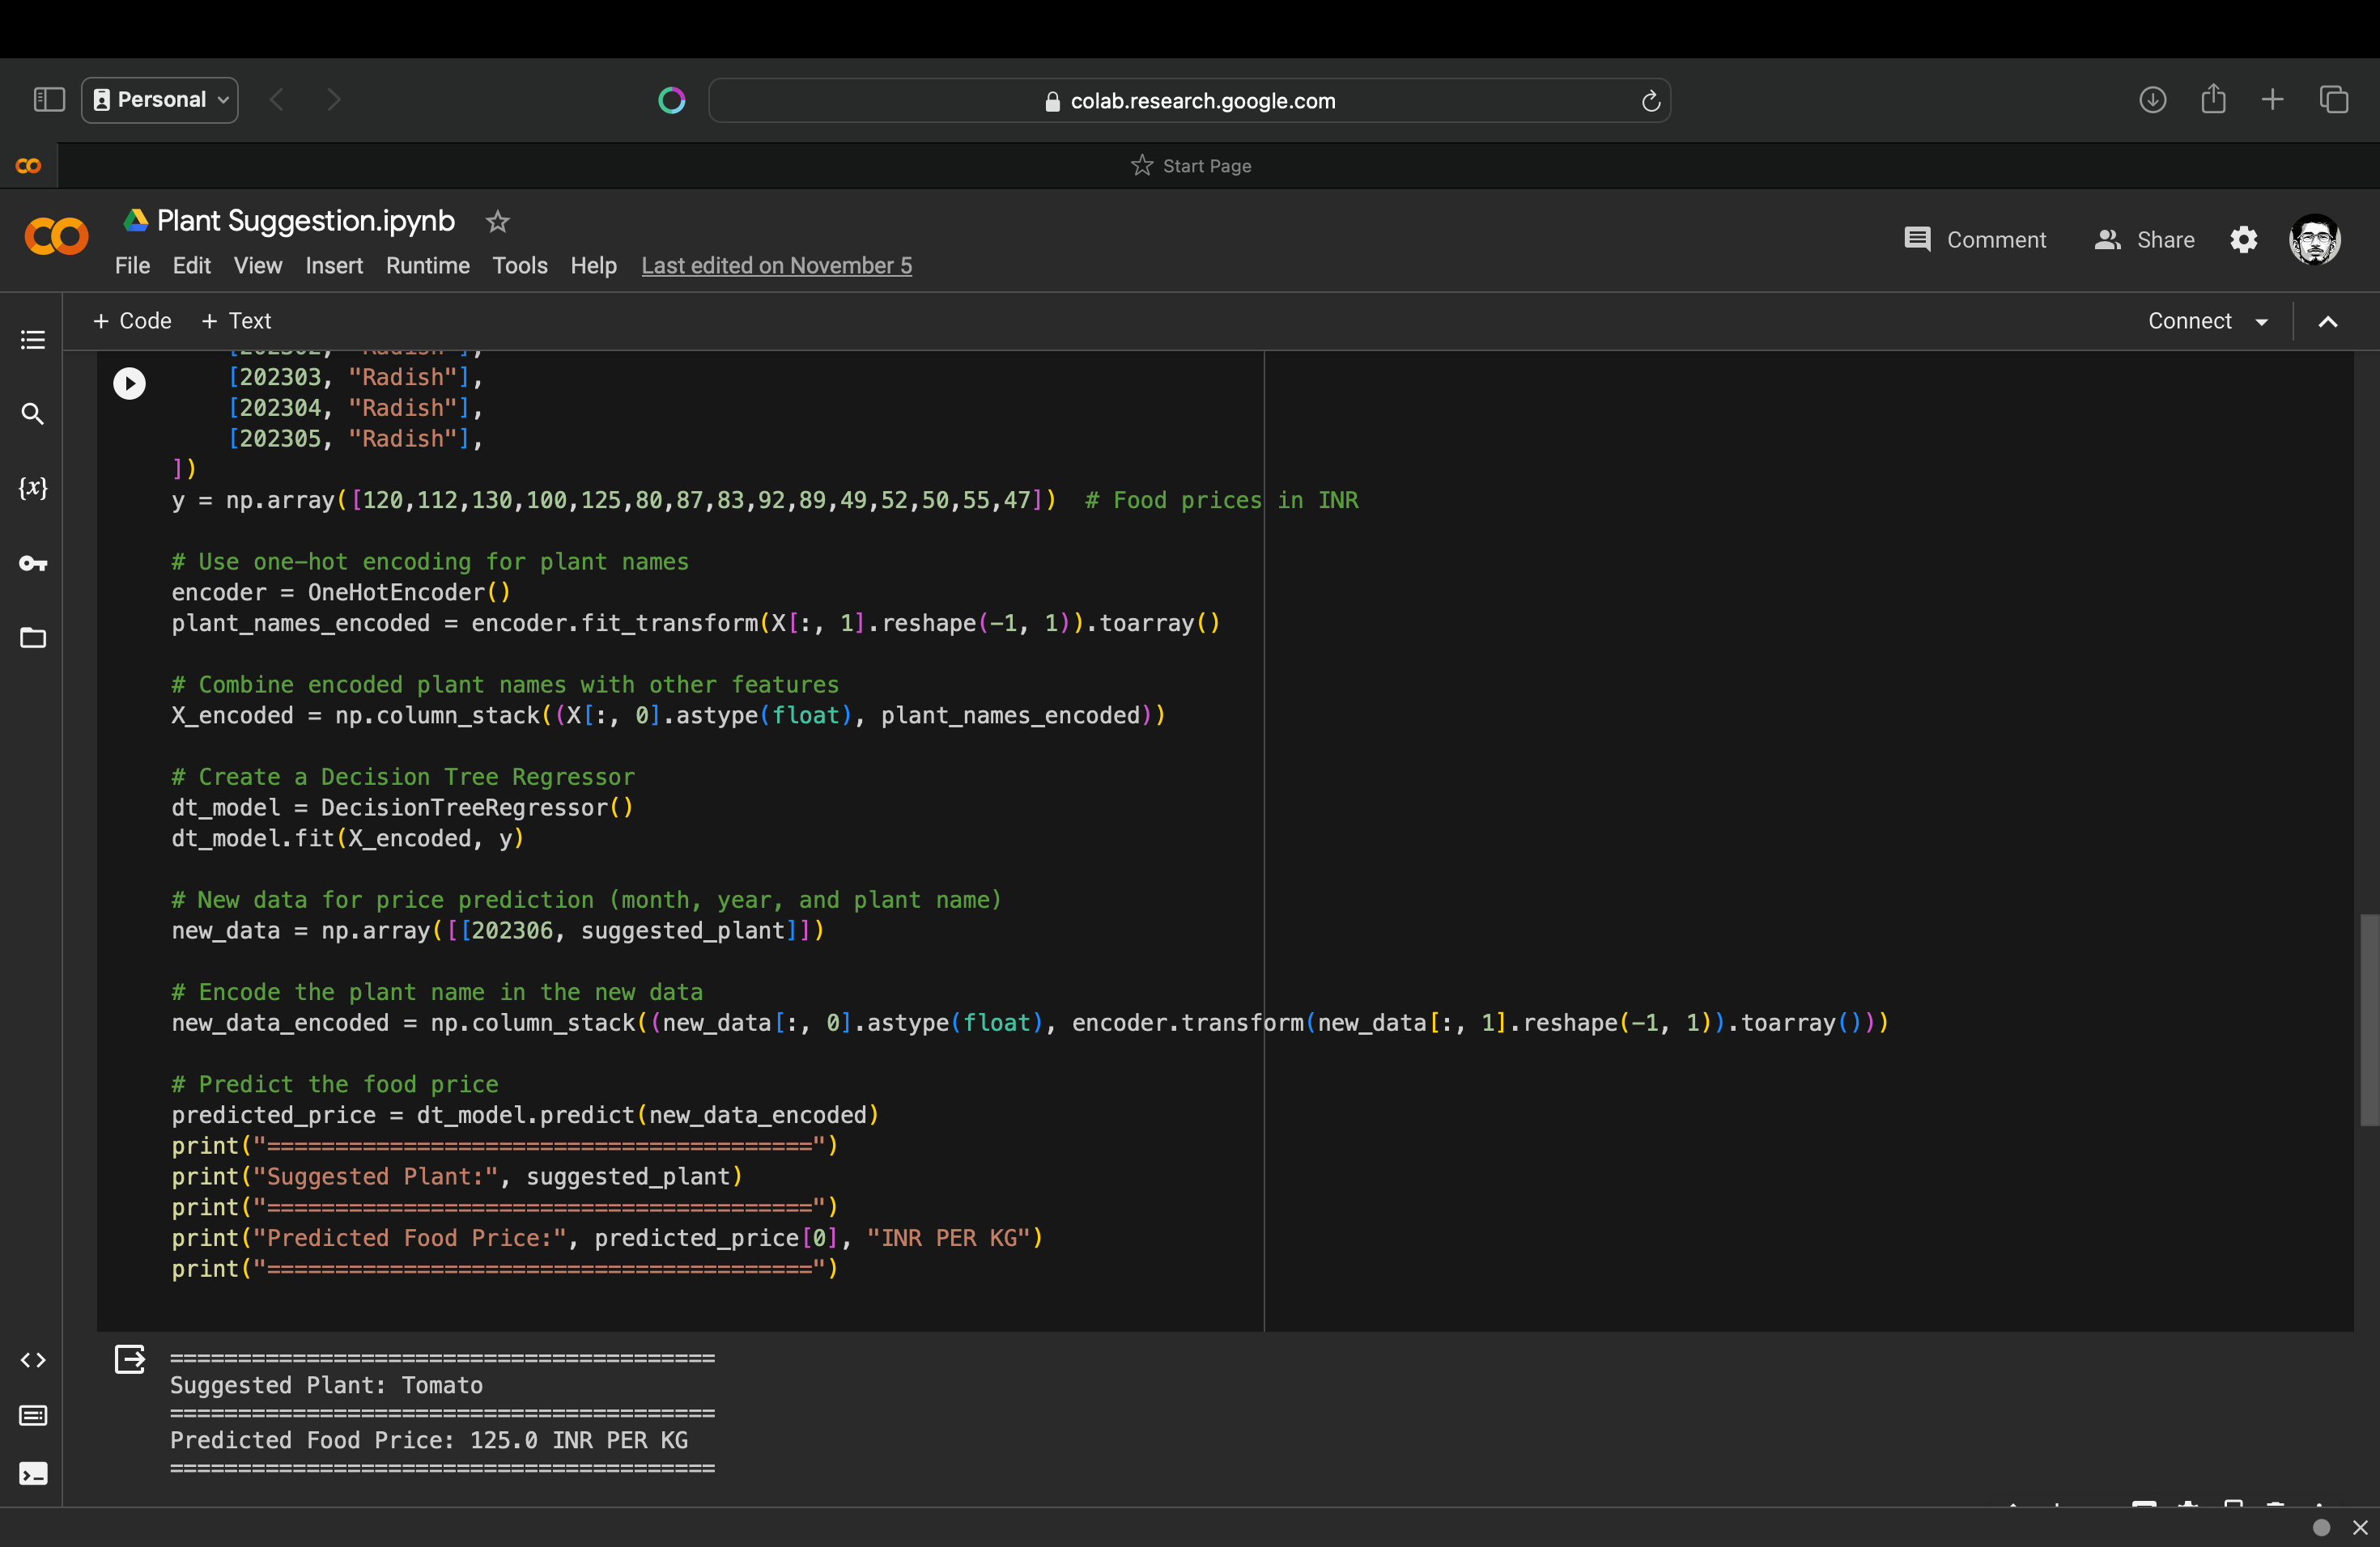
MODEL DEVELOPMENT AND TRAINING MODULE Implementation / Results

Slide 17
Module 4
Validation and Optimization Module
The "Validation and Optimization" module validates and fine-tunes the predictive model to ensure accuracy and reliability. It involves assessing the trained model's performance against historical data. If necessary, optimization techniques are applied to adjust model parameters, algorithms, or feature selections, improving predictive precision.
The module's outcome is a refined and validated predictive model that provides trustworthy insights for plant suggestions based on soil health and food prices.

Slide 18
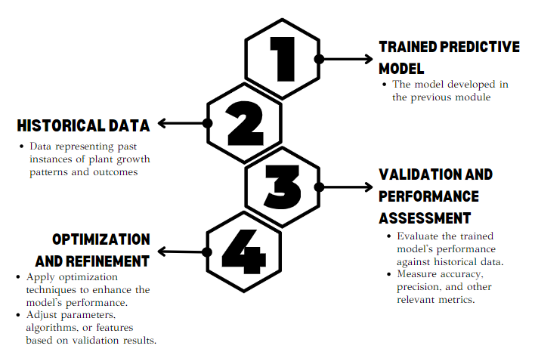
Validation and Optimization Module Data Flow Diagram

Slide 19
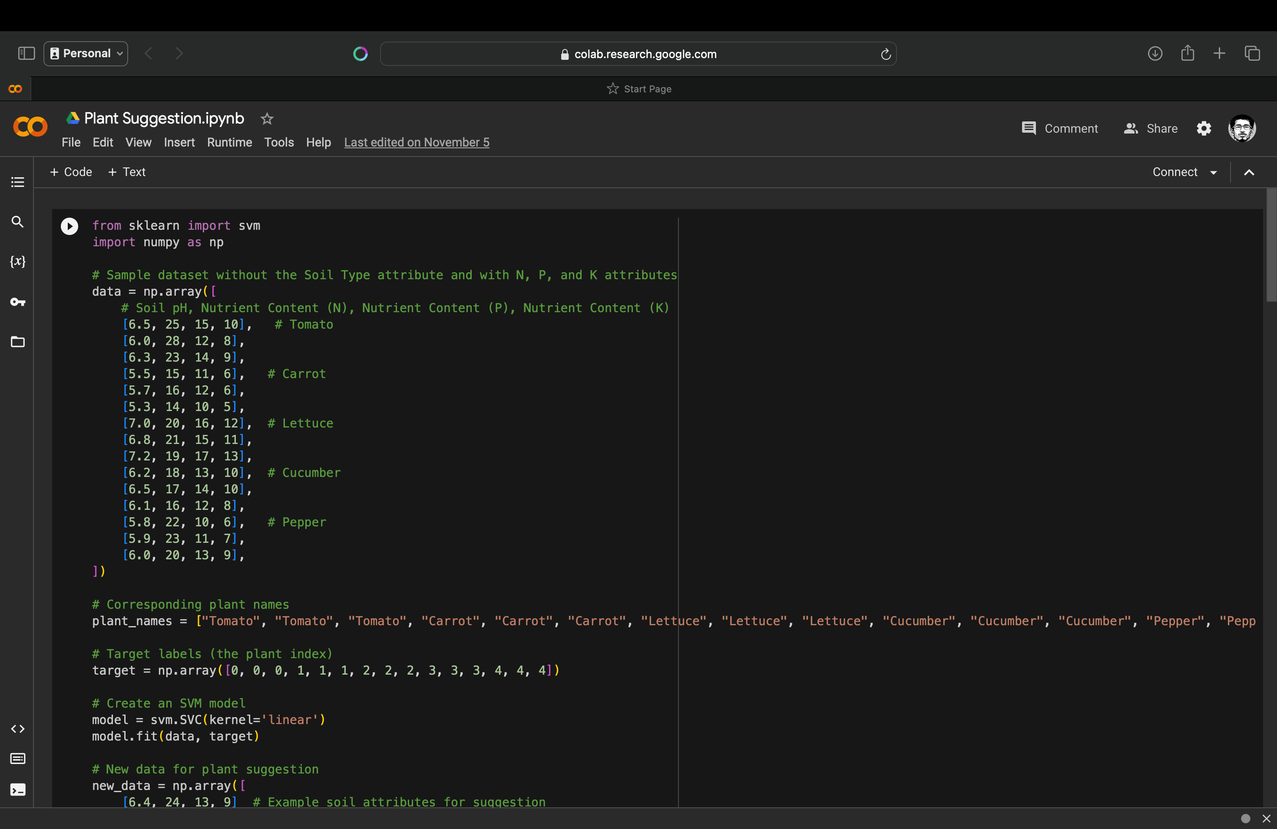
DEPLOYMENT AND MONITORING Results

Slide 20
REFERENCES
Jenskie Jerlin I. Haban , John Carlo V. Puno
Soil Fertilizer Recommendation System using Fuzzy Logic
2020 IEEE REGION 10 CONFERENCE (TENCON)
Pradeepta Kumar Sarangi; Deepti Sinha; Sachin Sinha; Neetu Mittal
Machine Learning Approach for the Prediction of Consumer Food Price Index
2021 9th International Conference on Reliability, Infocom Technologies and Optimization (Trends and Future Directions) (ICRITO)
Kartika CanFatima A.S Binofai; Maha O. A Mohamad;Mustapha D. Ibrahim
SWOT-4Ps analysis of UAE Organic food market
2022 Advances in Science and Engineering Technology International Conferences (ASET)
Juliana Ngozi Ndunagu; Helen Aderemi; Joseph Bamidele Awotunde
Time Series: Predicting Nigerian Food Prices using ARIMA Model and R-Programming
2022 5th Information Technology for Education and Development (ITED)
Yufei Zhao; Chao Huang; Jiebo Luo
How to Prepare for the Next Pandemic - Investigation of Correlation Between Food Prices and COVID-19 From Global and Local Perspectives
2022 IEEE International Conference on Big Data (Big Data)

Slide 21
Thank You!

